Slide 1
COT5615: Math for Intelligent Systems I
Anand Rangarajan
Lecture 37

Slide 2
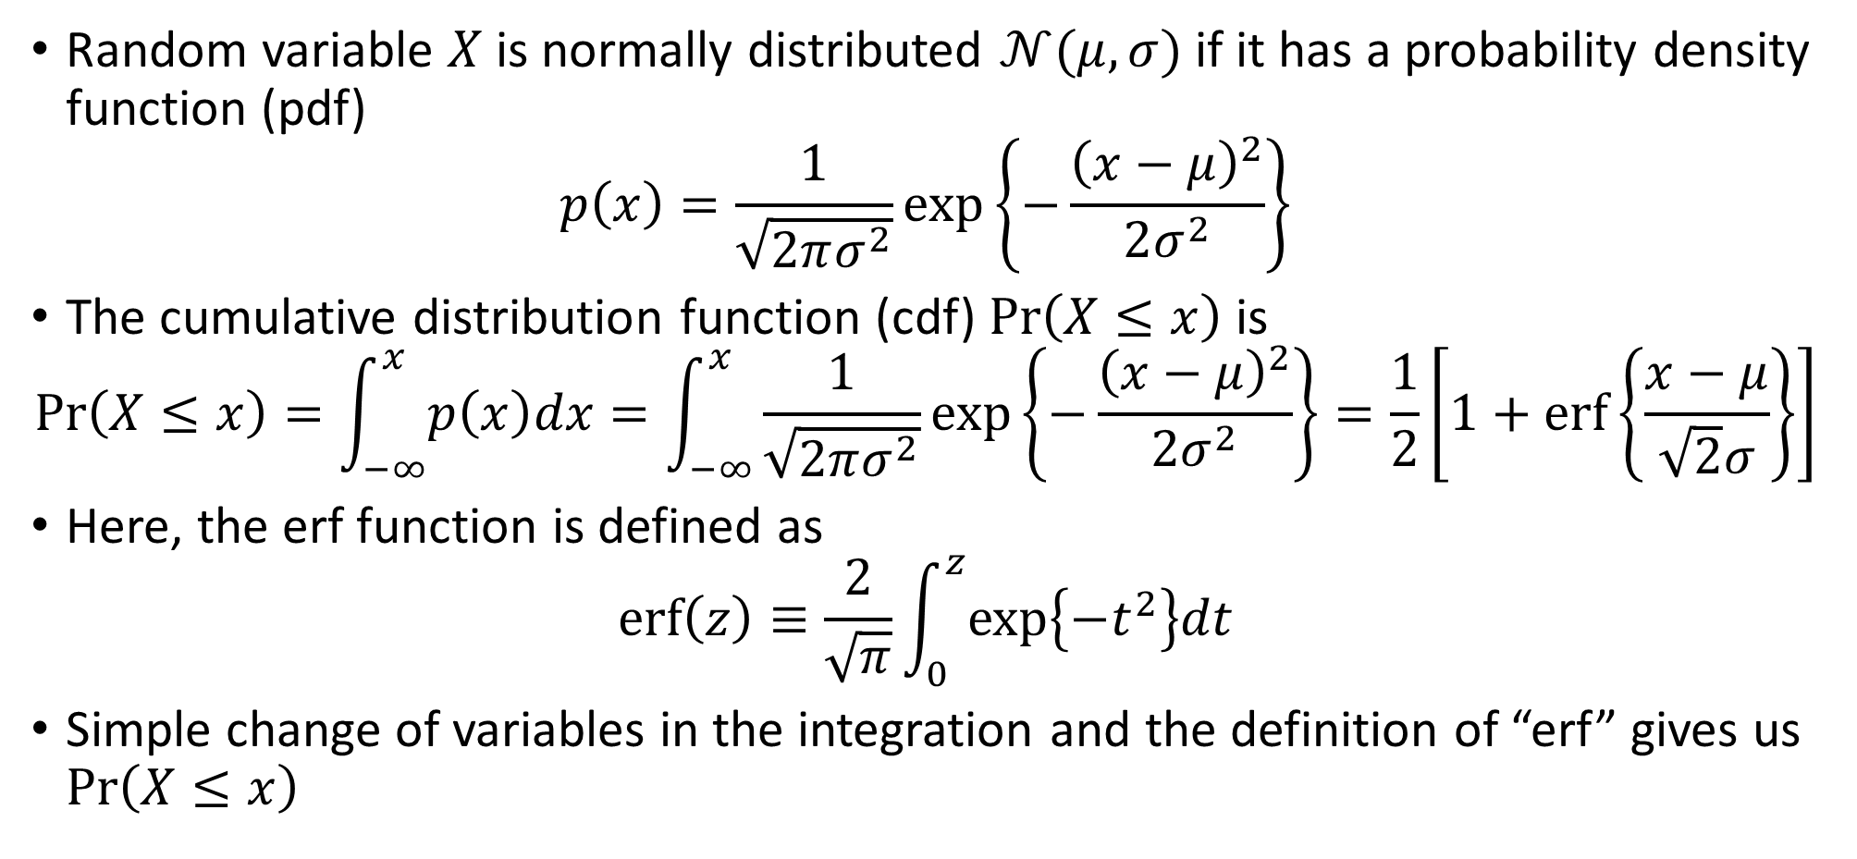
The Gaussian Distribution
Random variable $X$ is normally distributed $𝒩(μ,σ)$ if it has a probability density function (pdf)
$$p\left(x\right)=\frac{1}{\sqrt{2πσ^{2}}}\exp\left\{−\frac{{\left(x−μ\right)}^{2}}{2σ^{2}}\right\}$$
The cumulative distribution function (cdf) $\operatorname{Pr}\left(X≤x\right)$ is
$$\operatorname{Pr}\left(X≤x\right)=\int_{−∞}^{x}{p\left(x\right)dx}=\int_{−∞}^{x}{\frac{1}{\sqrt{2πσ^{2}}}\exp\left\{−\frac{{\left(x−μ\right)}^{2}}{2σ^{2}}\right\}}=\frac{1}{2}\left[1+\operatorname{erf}\left\{\frac{x−μ}{\sqrt{2}σ}\right\}\right]$$
Here, the erf function is defined as
$$\operatorname{erf}\left(z\right)≡\frac{2}{\sqrt{π}}\int_{0}^{z}{\exp\left\{−t^{2}\right\}dt}$$
Simple change of variables in the integration and the definition of “erf” gives us $\operatorname{Pr}\left(X≤x\right)$

Slide 3
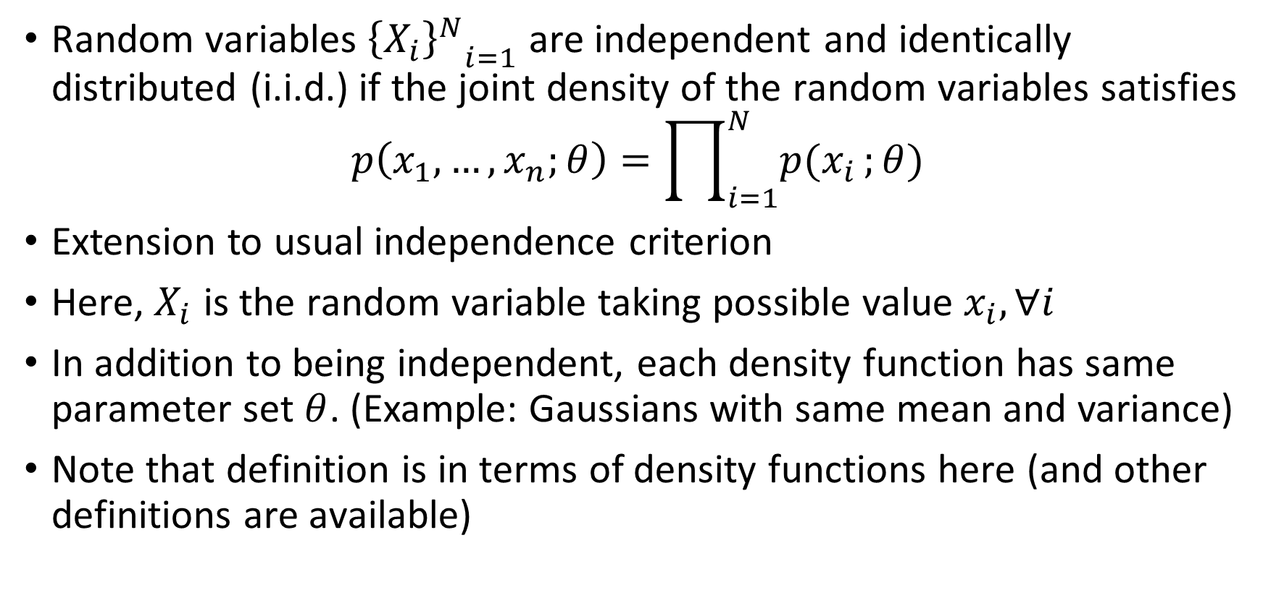
Independent and Identically Distributed
Random variables ${{\left\{X_{i}\right\}}^{N}}_{i=1}$ are independent and identically distributed (i.i.d.) if the joint density of the random variables satisfies
$$p\left(x_{1},…,x_{n};θ\right)=\prod_{i=1}^{N}{p(x_{i}};θ)$$
Extension to usual independence criterion
Here, $X_{i}$ is the random variable taking possible value $x_{i}, ∀i$
In addition to being independent, each density function has same parameter set $θ$. (Example: Gaussians with same mean and variance)
Note that definition is in terms of density functions here (and other definitions are available)

Slide 4
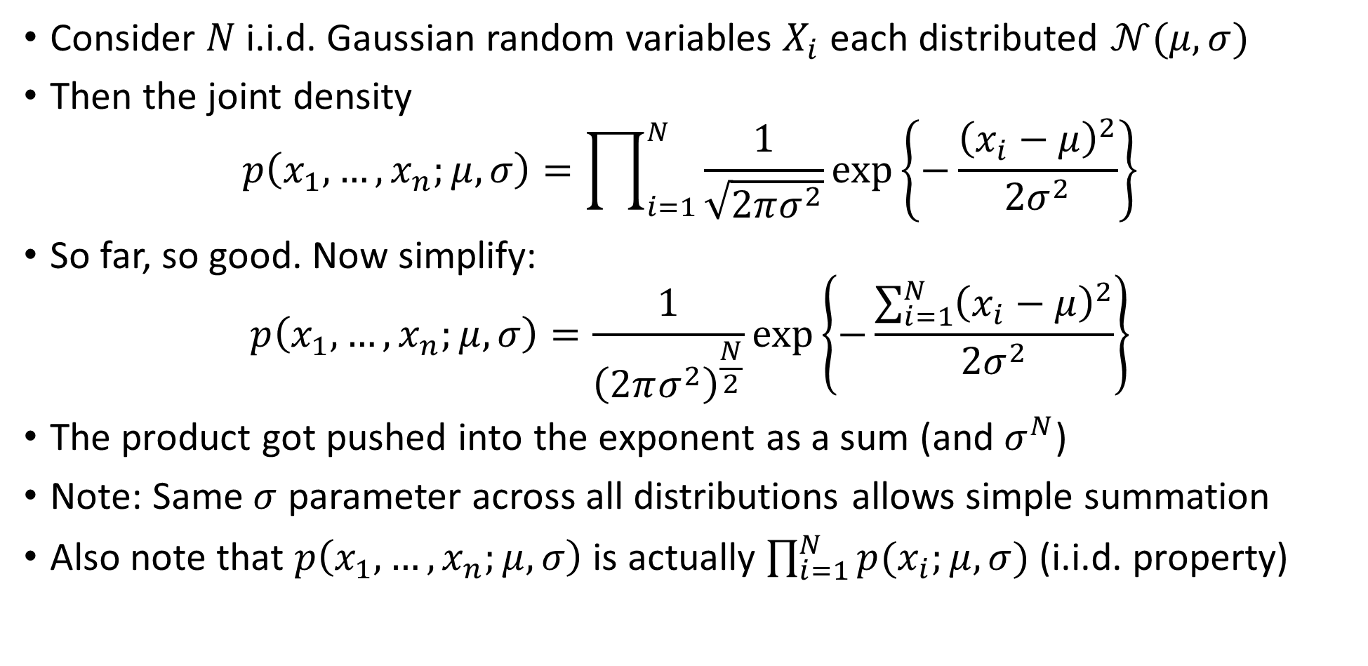
Application to Gaussian random variables
Consider $N$ i.i.d. Gaussian random variables $X_{i}$ each distributed $𝒩(μ,σ)$
Then the joint density
$$p\left(x_{1},…,x_{n};μ,σ\right)=\prod_{i=1}^{N}{\frac{1}{\sqrt{2πσ^{2}}}}\exp\left\{−\frac{{\left(x_{i}−μ\right)}^{2}}{2σ^{2}}\right\}$$
So far, so good. Now simplify:
$$p\left(x_{1},…,x_{n};μ,σ\right)=\frac{1}{{\left(2πσ^{2}\right)}^{\frac{N}{2}}}\exp\left\{−\frac{\sum_{i=1}^{N}{{\left(x_{i}−μ\right)}^{2}}}{2σ^{2}}\right\}$$
The product got pushed into the exponent as a sum (and $σ^{N}$)
Note: Same $σ$ parameter across all distributions allows simple summation
Also note that $p\left(x_{1},…,x_{n};μ,σ\right)$ is actually $\prod_{i=1}^{N}{p(x_{i};μ,σ)}$ (i.i.d. property)

Slide 5
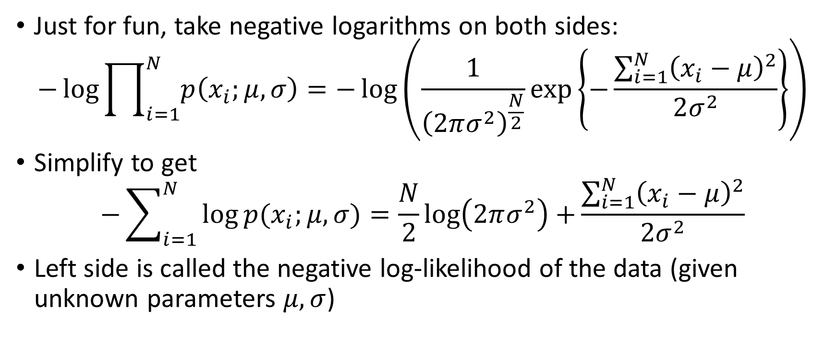
Application (contd.)
Just for fun, take negative logarithms on both sides:
$$−\log{\prod_{i=1}^{N}{p\left(x_{i};μ,σ\right)}}=−\log\left(\frac{1}{{\left(2πσ^{2}\right)}^{\frac{N}{2}}}\exp\left\{−\frac{\sum_{i=1}^{N}{{\left(x_{i}−μ\right)}^{2}}}{2σ^{2}}\right\}\right)$$
Simplify to get
$$−\sum_{i=1}^{N}{\log{p(x_{i};μ,σ)}=\frac{N}{2}\log\left(2πσ^{2}\right)+}\frac{\sum_{i=1}^{N}{{\left(x_{i}−μ\right)}^{2}}}{2σ^{2}}$$
Left side is called the negative log-likelihood of the data (given unknown parameters $μ,σ$)

Slide 6
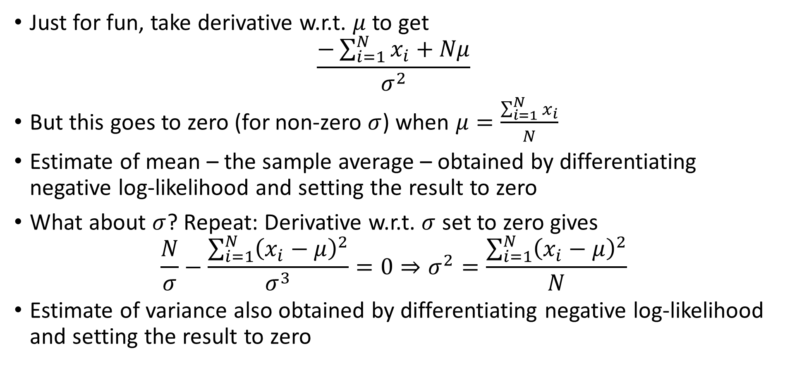
Application (contd.)
Just for fun, take derivative w.r.t. $μ$ to get
$$\frac{−\sum_{i=1}^{N}{x_{i}}+Nμ}{σ^{2}}$$
But this goes to zero (for non-zero $σ$) when $μ=\frac{\sum_{i=1}^{N}{x_{i}}}{N}$
Estimate of mean – the sample average – obtained by differentiating negative log-likelihood and setting the result to zero
What about $σ$? Repeat: Derivative w.r.t. $σ$ set to zero gives
$$\frac{N}{σ}−\frac{\sum_{i=1}^{N}{{\left(x_{i}−μ\right)}^{2}}}{σ^{3}}=0⇒σ^{2}=\frac{\sum_{i=1}^{N}{{\left(x_{i}−μ\right)}^{2}}}{N}$$
Estimate of variance also obtained by differentiating negative log-likelihood and setting the result to zero

Slide 7
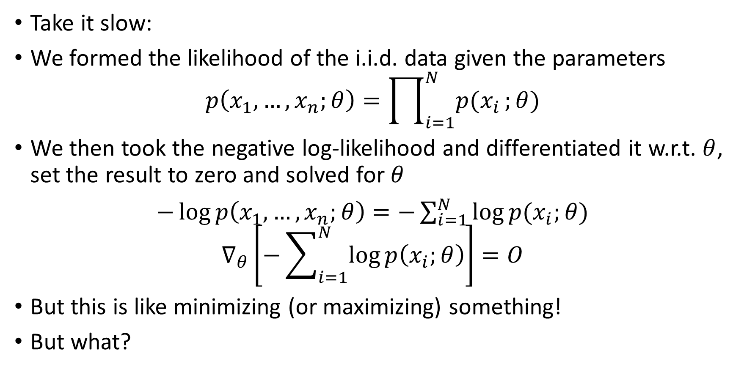
What does this mean?
Take it slow:
We formed the likelihood of the i.i.d. data given the parameters
$$p\left(x_{1},…,x_{n};θ\right)=\prod_{i=1}^{N}{p(x_{i}};θ)$$
We then took the negative log-likelihood and differentiated it w.r.t. $θ$, set the result to zero and solved for $θ$
$−\log{p\left(x_{1},…,x_{n};θ\right)}=−\sum_{i=1}^{N}{\log{p(x_{i};θ)}}$
$$∇_{θ}\left[−\sum_{i=1}^{N}{\log{p\left(x_{i};θ\right)}}\right]=O$$
But this is like minimizing (or maximizing) something!
But what?

Slide 8
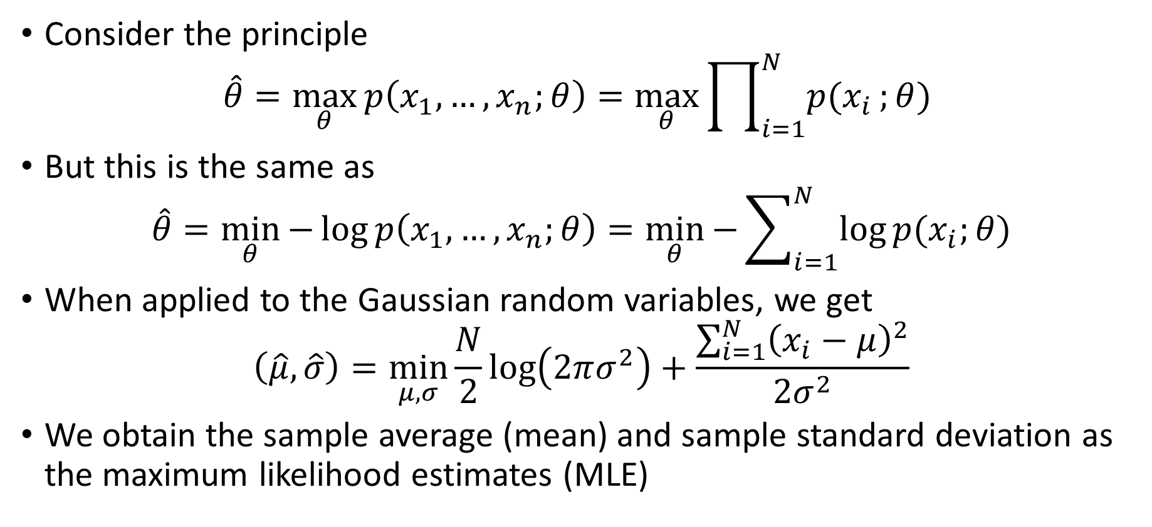
Maximum Likelihood
Consider the principle
$$\hat{θ}=\max_{θ}{p\left(x_{1},…,x_{n};θ\right)}=\max_{θ}{\prod_{i=1}^{N}{p(x_{i}};θ) }$$
But this is the same as
$$\hat{θ}=\min_{θ}{−\log{p\left(x_{1},…,x_{n};θ\right)}}=\min_{θ}{−\sum_{i=1}^{N}{\log{p(x_{i};θ)}}}$$
When applied to the Gaussian random variables, we get
$$\left(\hat{μ},\hat{σ}\right)=\min_{μ,σ}{\frac{N}{2}\log\left(2πσ^{2}\right)+\frac{\sum_{i=1}^{N}{{\left(x_{i}−μ\right)}^{2}}}{2σ^{2}}}$$
We obtain the sample average (mean) and sample standard deviation as the maximum likelihood estimates (MLE)

Slide 9
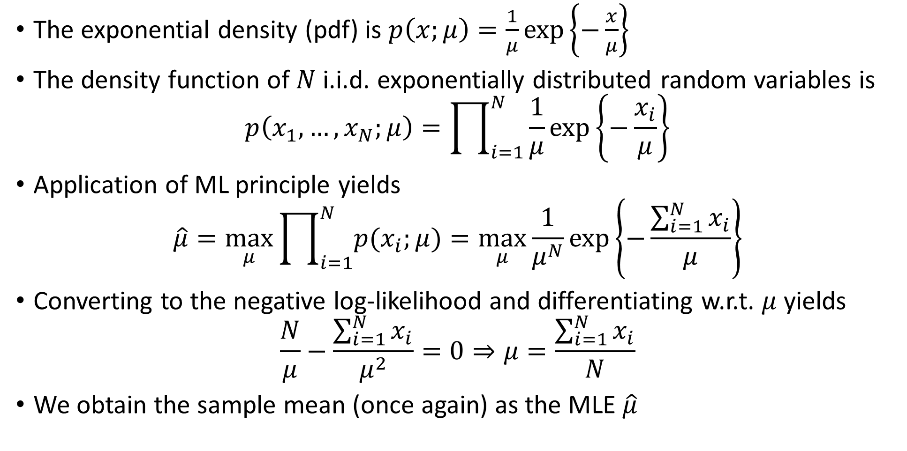
Application to the Exponential Distribution
The exponential density (pdf) is $p\left(x;μ\right)=\frac{1}{μ}\exp\left\{−\frac{x}{μ}\right\}$
The density function of $N$ i.i.d. exponentially distributed random variables is
$$p\left(x_{1},…,x_{N};μ\right)=\prod_{i=1}^{N}{\frac{1}{μ}\exp\left\{−\frac{x_{i}}{μ}\right\}}$$
Application of ML principle yields
$$\hat{μ}=\max_{μ}{\prod_{i=1}^{N}{p(x_{i};μ)}}=\max_{μ}\frac{1}{μ^{N}}\exp\left\{−\frac{\sum_{i=1}^{N}{x_{i}}}{μ}\right\}$$
Converting to the negative log-likelihood and differentiating w.r.t. $μ$ yields
$$\frac{N}{μ}−\frac{\sum_{i=1}^{N}{x_{i}}}{μ^{2}}=0⇒μ=\frac{\sum_{i=1}^{N}{x_{i}}}{N}$$
We obtain the sample mean (once again) as the MLE $\hat{μ}$

Slide 10
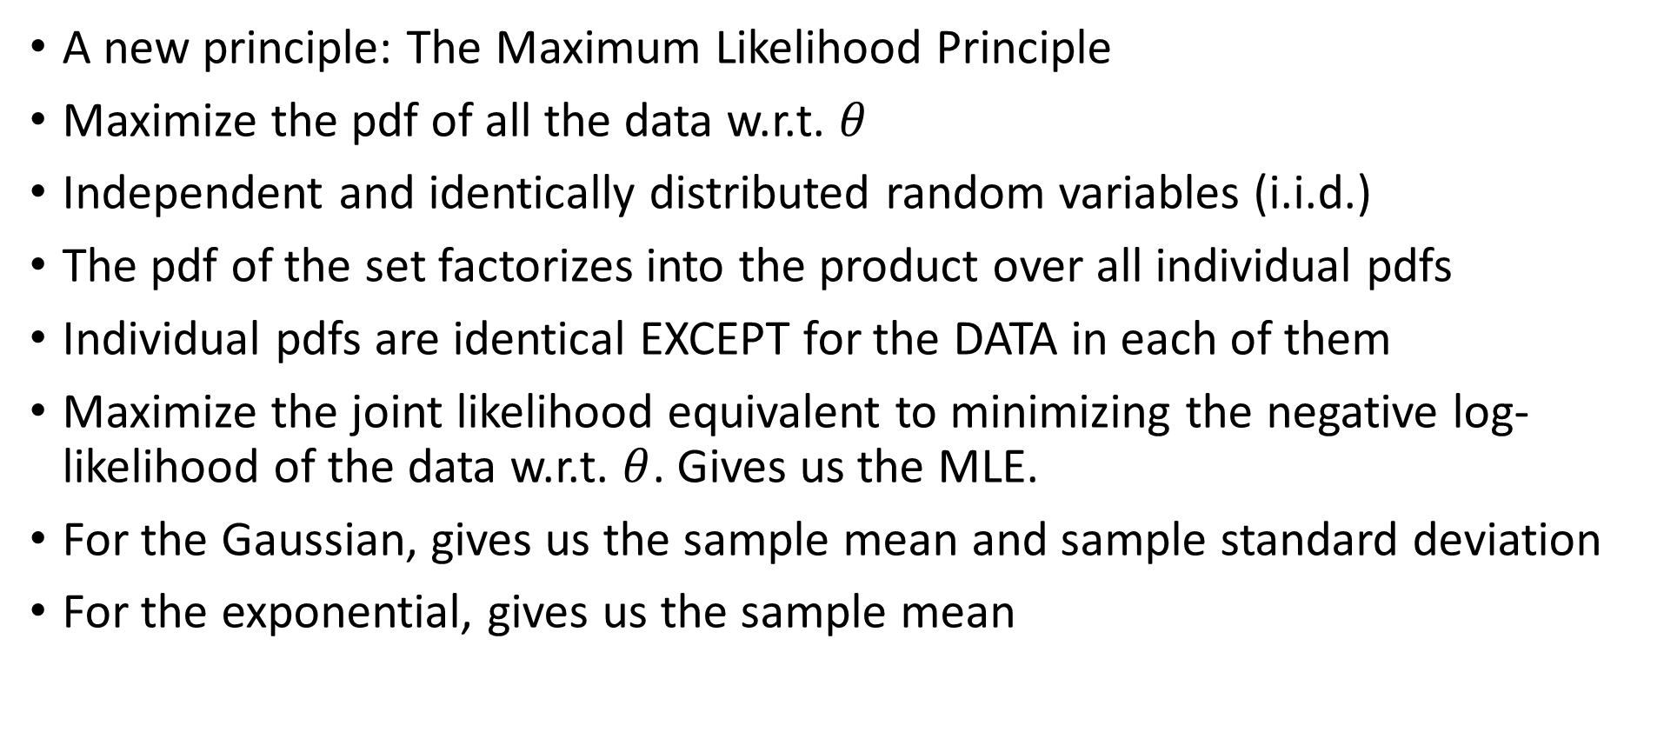
Summary
A new principle: The Maximum Likelihood Principle
Maximize the pdf of all the data w.r.t. $θ$
Independent and identically distributed random variables (i.i.d.)
The pdf of the set factorizes into the product over all individual pdfs
Individual pdfs are identical EXCEPT for the DATA in each of them
Maximize the joint likelihood equivalent to minimizing the negative log-likelihood of the data w.r.t. $θ$. Gives us the MLE.
For the Gaussian, gives us the sample mean and sample standard deviation
For the exponential, gives us the sample mean

